Slide 1
Introduction to Machine Learning
Neha Baranwal

Slide 2
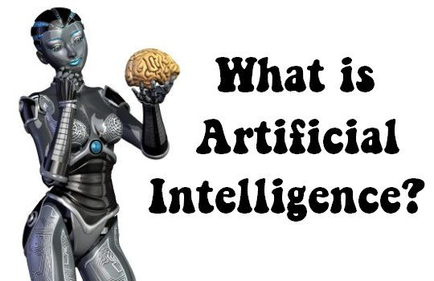
The power of a machine to copy intelligent human behavior. Right???

Slide 3
Examples of AI
Autonomous Cars
Chatbot
Drones
Many More
Human vs Computer games
Robot

Slide 4


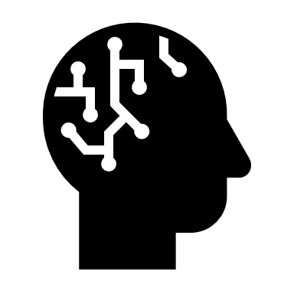
AI vs Machine Learning vs Deep Learning
AI
ML
DL
Artificial intelligence is the ability of a computer to perform tasks commonly associated with intelligent beings. (John McCarthy, 1956)
Machine learning is the study of algorithms that learn from examples and experience instead of relying on hard-coded rules and make predictions on new data.(Arthur Samuel, 1959)
Deep learning is a subfield of machine learning focusing on learning data representations as successive layers of increasingly meaningful representations.

Slide 5
What is machine learning?
Machine learning is the study of algorithms that learn from examples and experience instead of relying on hard-coded rules and make predictions on new data.

Slide 6
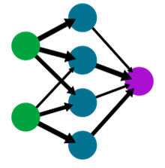
What is Machine Learning
Conventional Programming
Write a program to check if the number is prime or not
Machine Learning
START
Enter a number N
Second hidden layer
i=1, counter = 0
First hidden layer
If i<= N
True
If N % i == 0
Input layer
Output layer
False
True
False
Training Samples
i = i+1
Input | Output
5 | 1
4 | 0
12 | 0
21 | 0
23 | 1
29 | 1
30 | 0
Counter = counter +1
If counter == 2
False
True
Not a prime number
It’s a prime number

Slide 7
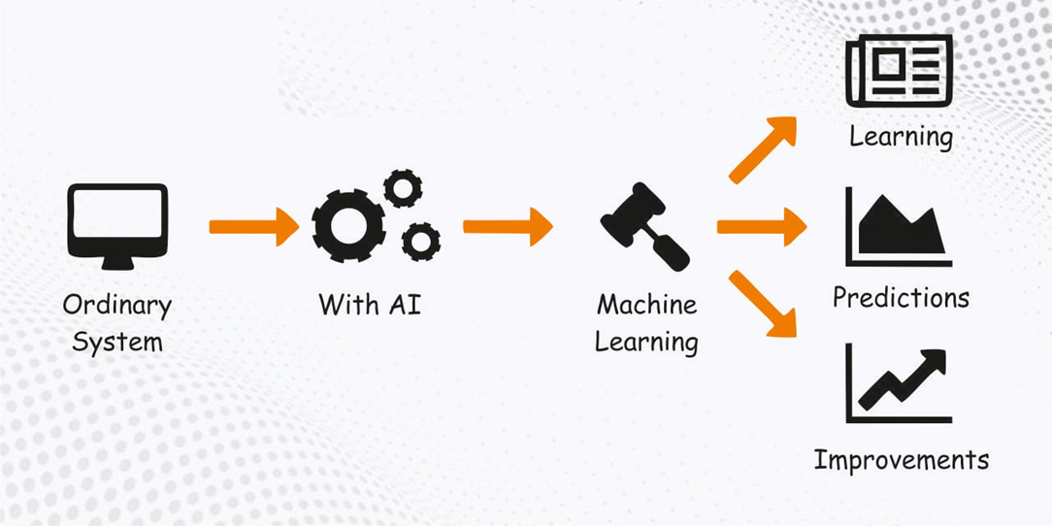
Why Machine Learning is Important?

Slide 8
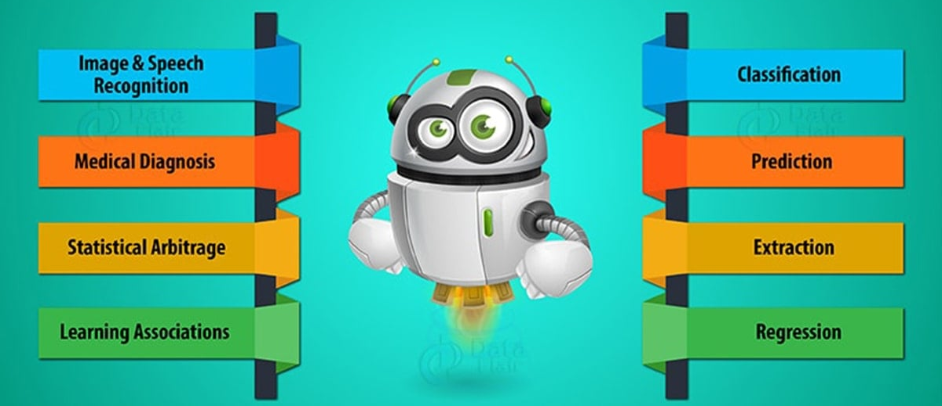
Machine Learning Applications

Slide 9
Main types of machine learning

Slide 10
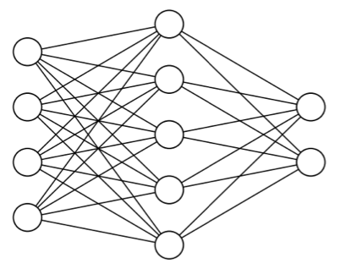

Main types of machine learning
Supervised learning
Unsupervised learning
Self-supervised learning
Reinforcement learning
cat
dog

Slide 11
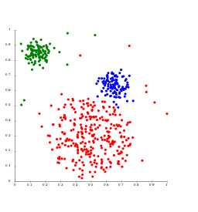
Main types of machine learning
Supervised learning
Unsupervised learning
Self-supervised learning
Reinforcement learning
By Chire [CC BY-SA 3.0], from Wikimedia Commons

Slide 12
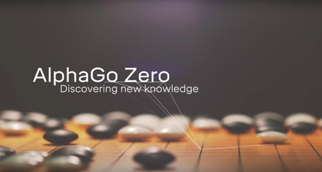
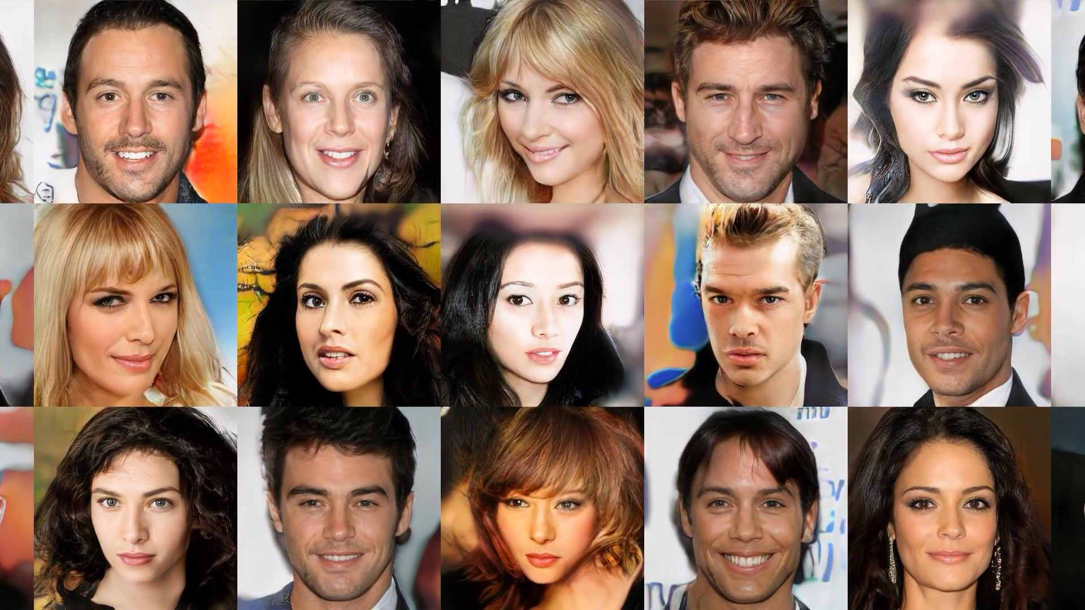
Main types of machine learning
Supervised learning
Unsupervised learning
Self-supervised learning
Reinforcement learning

Slide 13
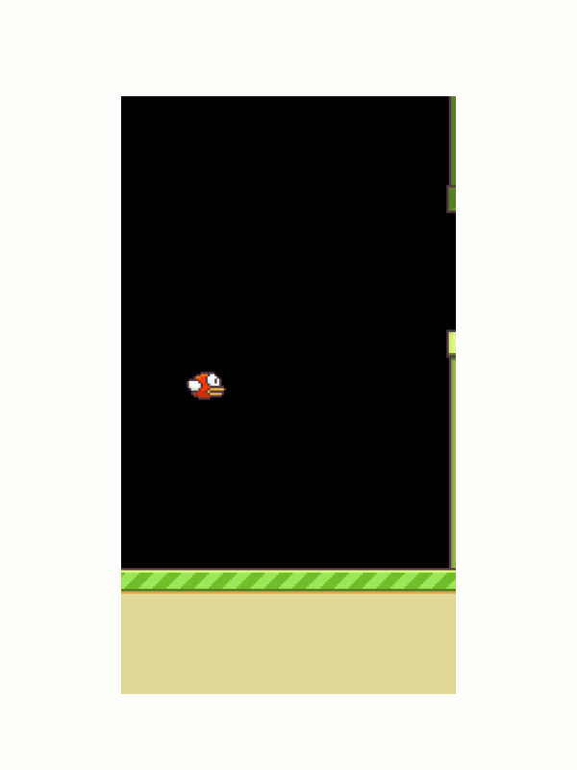
Main types of machine learning
Supervised learning
Unsupervised learning
Self-supervised learning
Reinforcement learning
upsidedown_half_cheetah.mp4

Slide 14
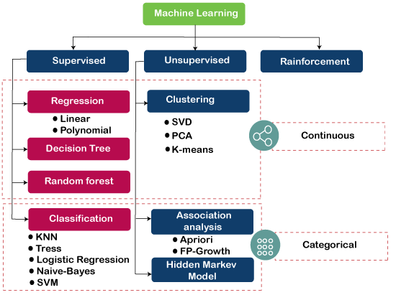
Machine Learning Algorithms

Slide 15
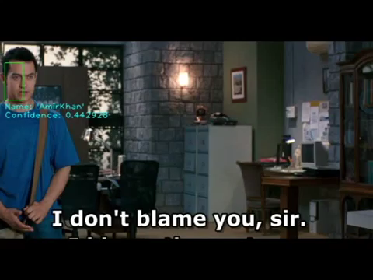
Person Identification

Slide 16
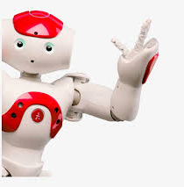
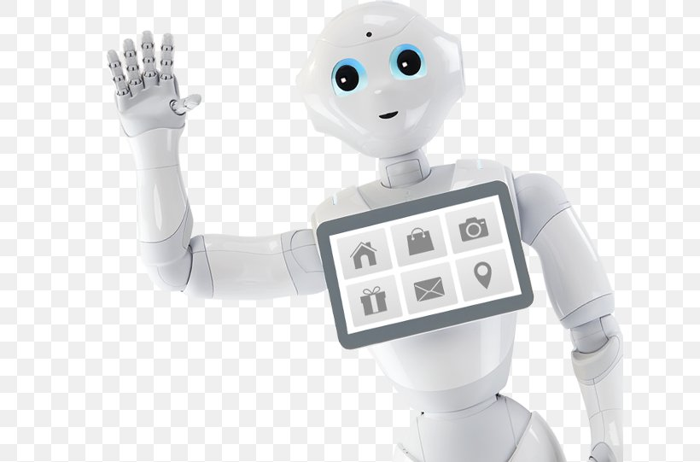
Thanks
Contact Details:
baranwal.neha24@gmail.com, neha.Baranwal@lirmm.fr
https://www.linkedin.com/in/dr-neha-baranwal-42632574/
https://scholar.google.se/citations?user=MBgGDPYAAAAJ&hl=en
https://github.com/robaita
https://www.facebook.com/RoboticsAndAITrainingAcademy
https://www.youtube.com/@robaita4318

